Slide 1


Mzamomtsha JS Improvements
Home
Introduction
Questions
Home
Team
Team
Introduction
Website
Website
Welcome to
TECH LOYALTIES

Slide 2
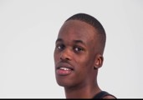
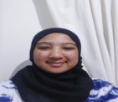
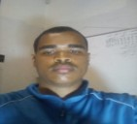
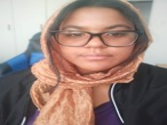

Home
Introduction
Questions
Home
Team
Team
Introduction
Website
Website
Hlombe Malandela
Yusrah Safedien
Ryan Goosen
Zainap Van Blerck
Lwazi Mdukulwana

Slide 3

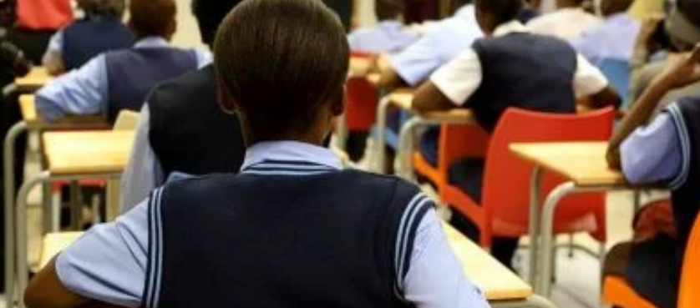
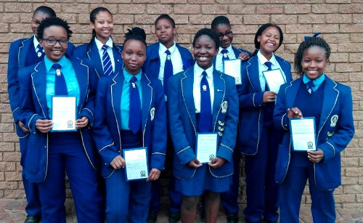
Home
Introduction
Questions
Home
Team
Team
Introduction
Website
Website
JavaScript Implementation Review
Last Week: Some validation, error handling, function expansion and pop-ups.
New JS improvements:
Navbar colour change
Div format
Image JS edits
Complete Input Validation

Slide 4
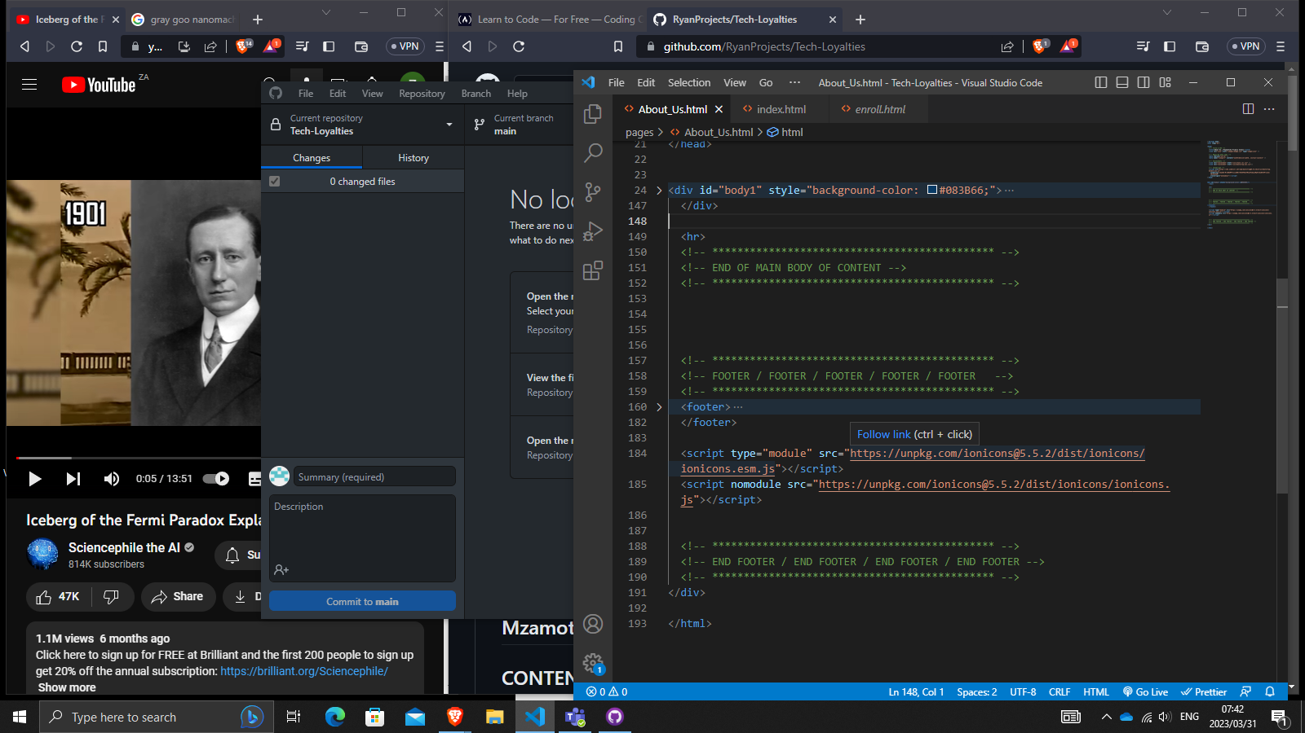
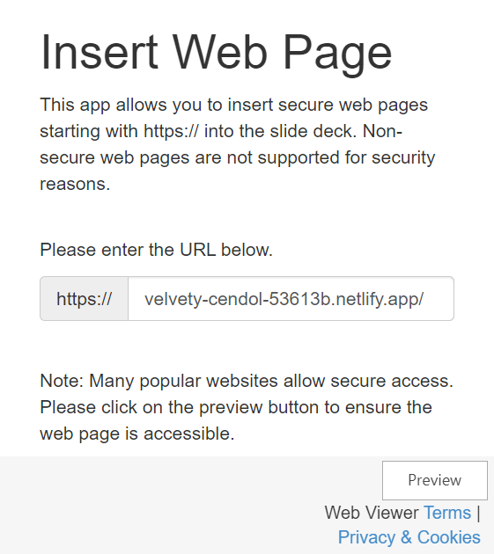
Div
Home
Team
Introduction
Questions

Slide 5
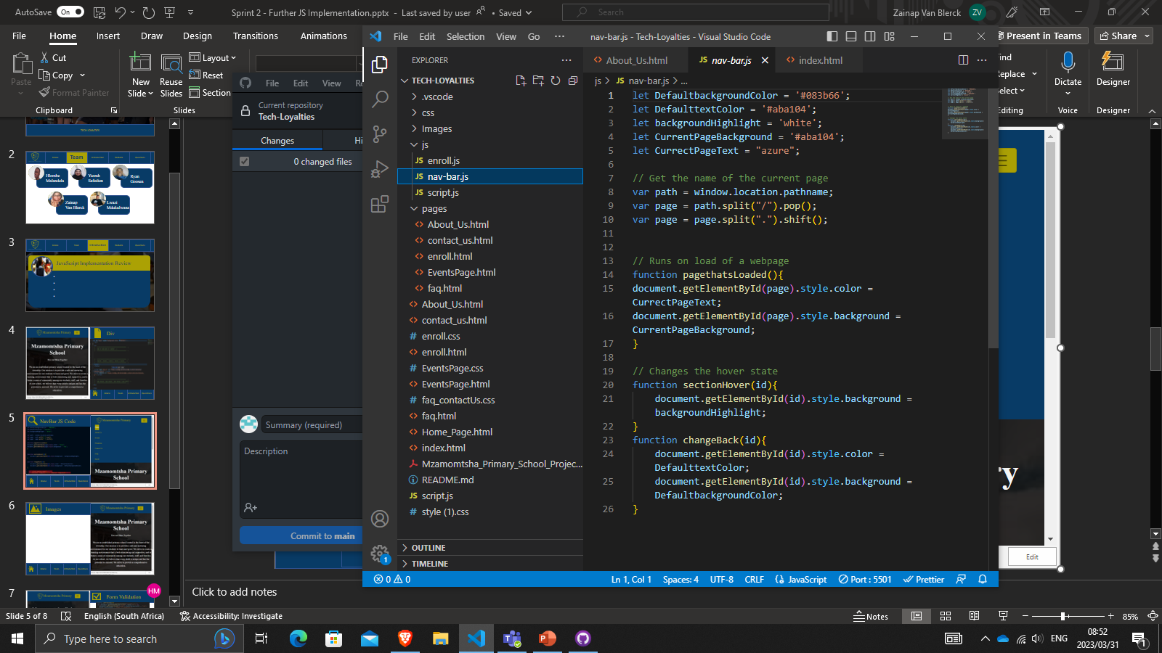
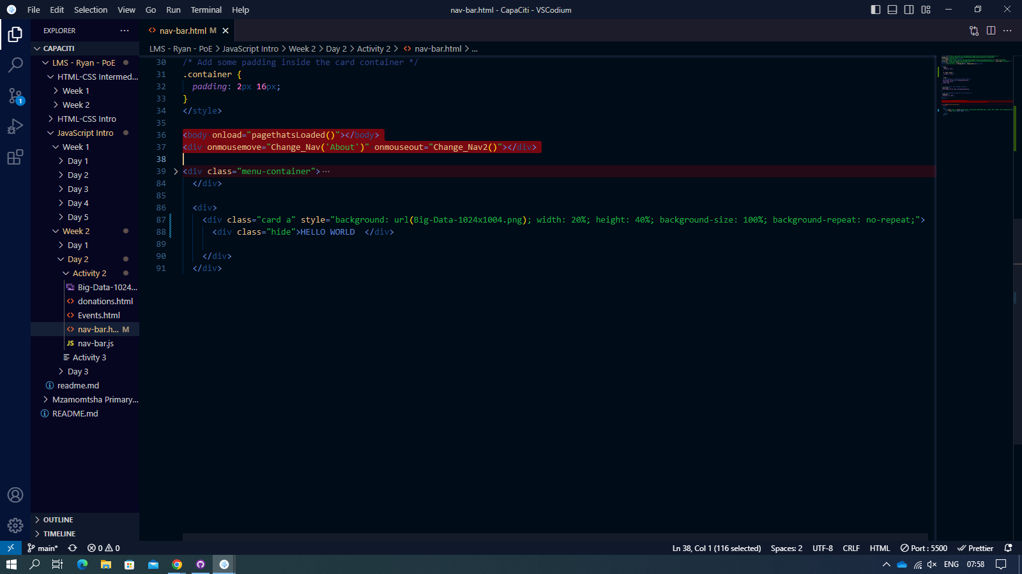
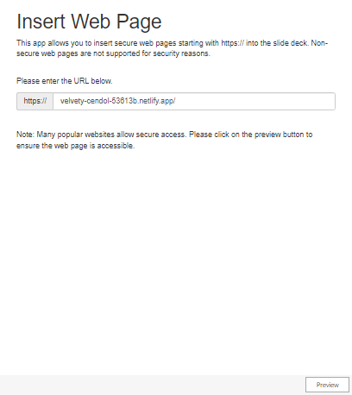
NavBar JS Code
Home
Team
Introduction
Questions

Slide 6
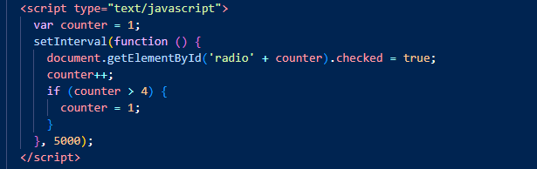
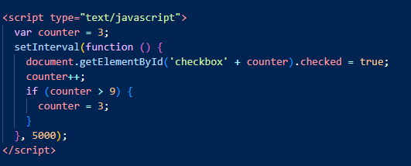
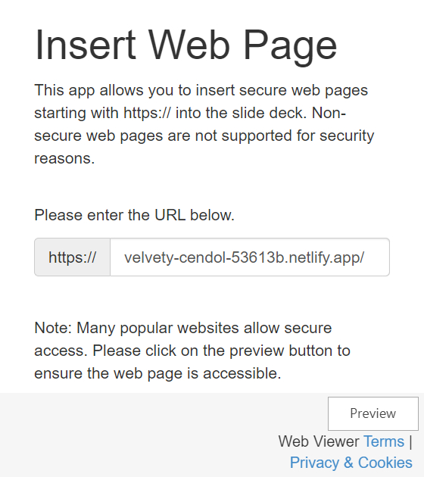
Images
Home
Team
Introduction
Questions

Slide 7
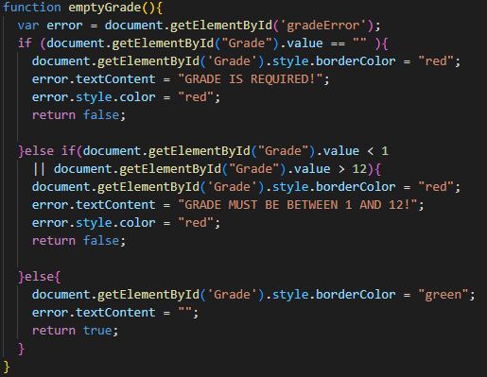
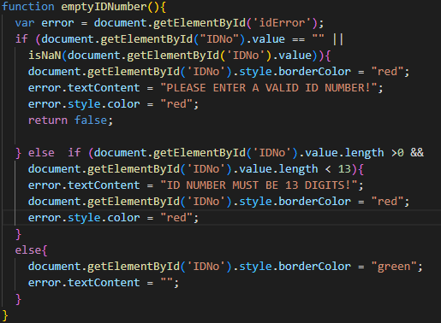
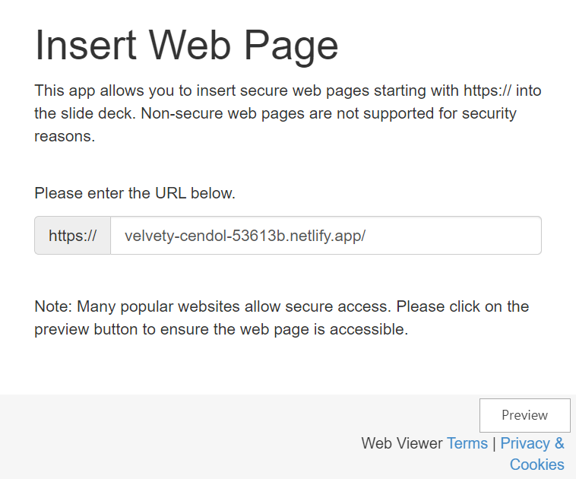
Form Validation
Home
Team
Introduction
Questions

Slide 8
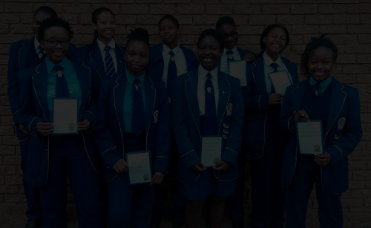
Home
Team
Introduction
Website
Questions
Any Questions
Thank You
Name
Candidate Member
Email
Candidate@capaciti.org.za
Description
...

